Slide 1
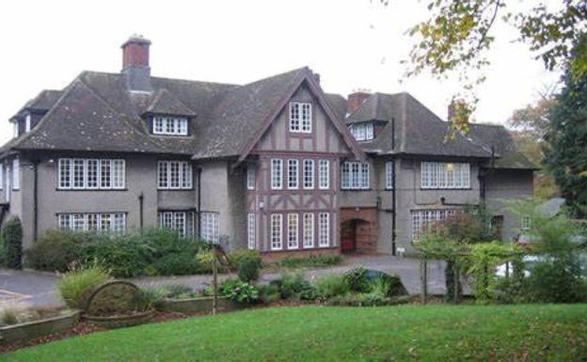
Braeside 2026
Itinerary
Who’s going
Braeside facilities
Bedrooms
Meals
Activities
Kit List
Further information

Slide 2
Wednesday 30th September – Friday 2nd October 2026
Arrive at school normal time!
Leave school on Wednesday 30th September @ 09:30
Arrive back on Friday 2nd October@ 14:30
Leave school at normal time!

Slide 3
 | Group 1 | Group 2
Wednesday | Arrive and welcome
 | Orienteering
 | Lunch (please bring your own)
 | Canoeing (Devizes Wharf) | Canoeing (Devizes Wharf)
 | Settling in time / House Rules
 | Dinner in the dining room
 | Nightline
 | Bed Time!
Thursday | Breakfast in the dining room
 | Survival Morning Fire Lighting & Lunch Cooking | Survival Morning Fire Lighting & Lunch Cooking
 | Lunch (eat what cooked on survival morning)
 | Low ropes Archery | Archery Low ropes
 | Dinner in the dining room
 | DT Challenge
 | Bed Time!
Friday | Strip beds and pack luggage then breakfast in dining room
 | Crate Stacking Climbing Wall & Zipwire | Climbing Wall & Zipwire Crate Stacking
 | Lunch (provided by Braeside)
 | Braeside Gift Shop
 | Depart for Home

Slide 4
Who’s going?
23 children
Mrs Wilson
Mrs Ray
Mr Mintram (Chair of Governors)

Slide 5
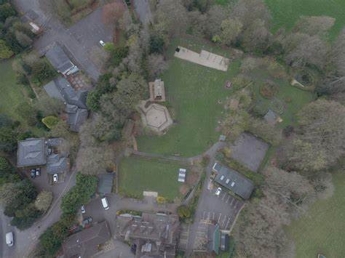
crate stacking
campfire/ survival area
climbing wall
low ropes
top lawn
forest
dining hall
main house

Slide 6
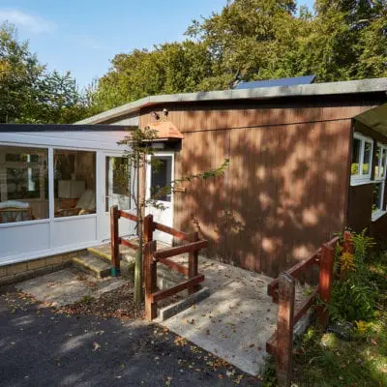
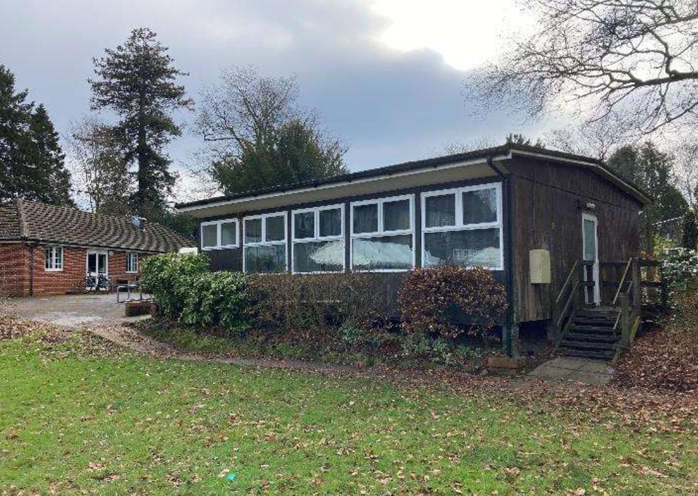
Our Accommodation – Beeches & Laurels!
The Laurels (Girls)
The Beeches (Boys)

Slide 7
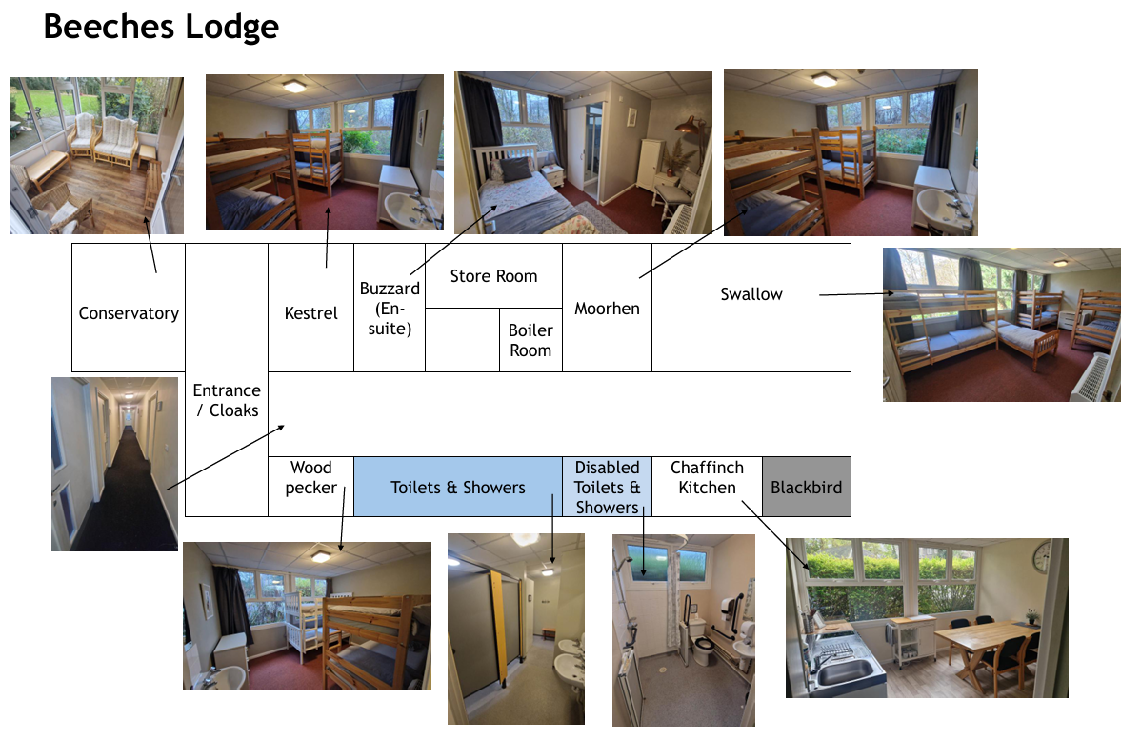
Mrs Wilson’s room
Mr Mintram’s room

Slide 8
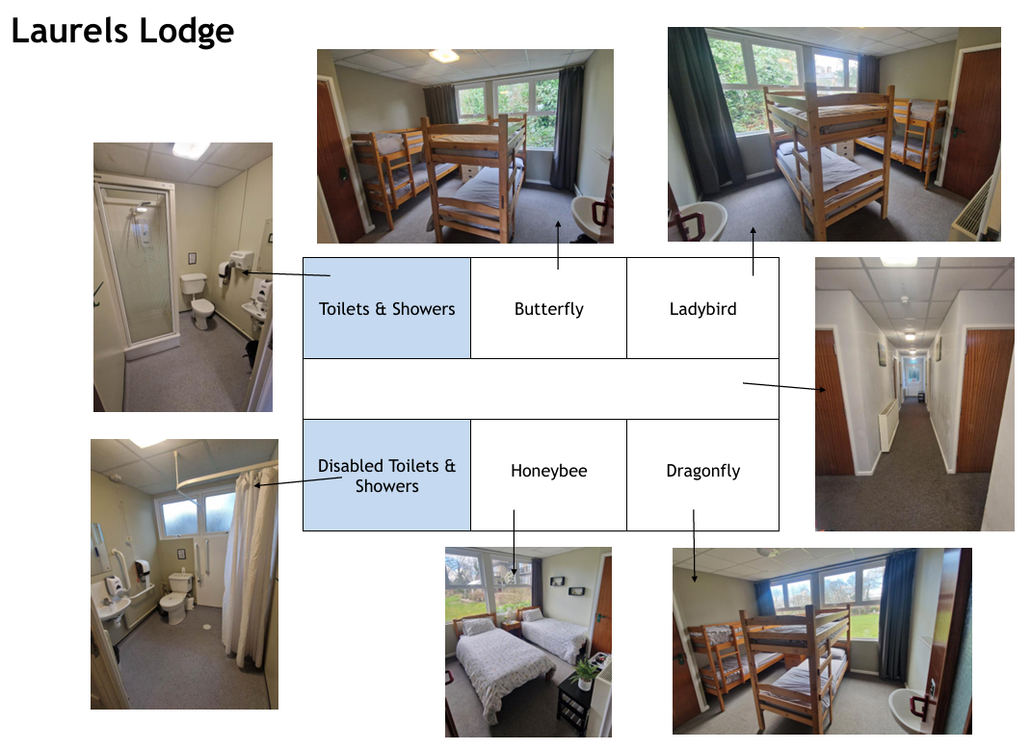
Mr Ray’s room

Slide 9
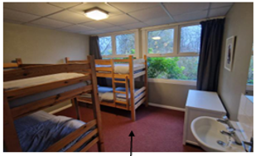
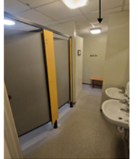
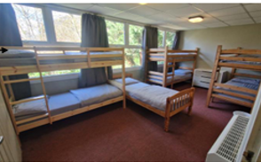
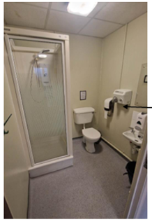
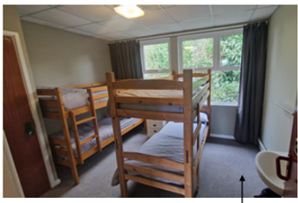
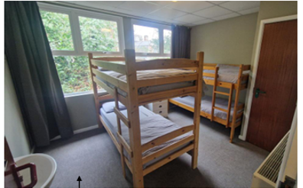
Small sized rooms all with a sink

Slide 10
Before the trip - children will organise themselves into bedroom groups.
We will sort this in September!
Bedtimes – 9pm
Lights out latest 10pm

Slide 11
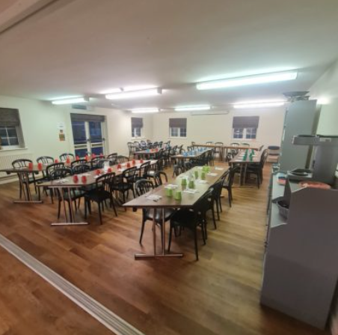
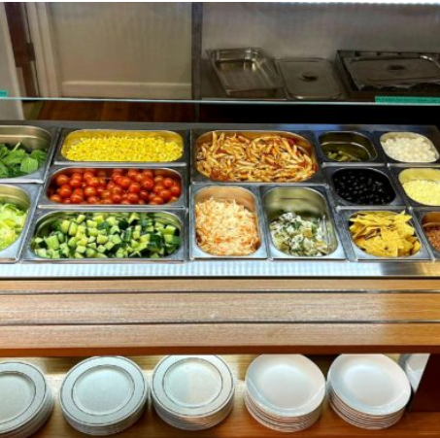
Great food!

Slide 12


Slide 13
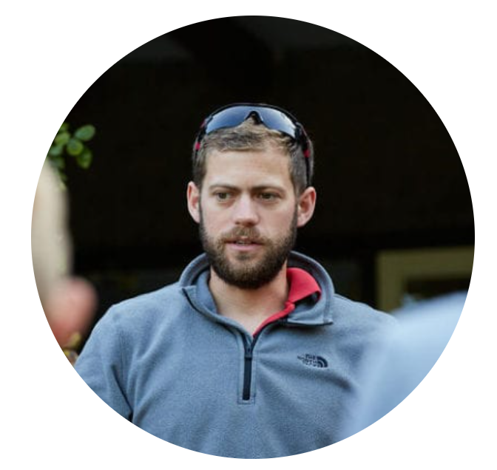
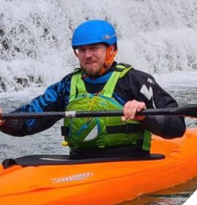
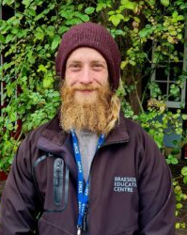
Cam
Josh
Dan

Slide 14
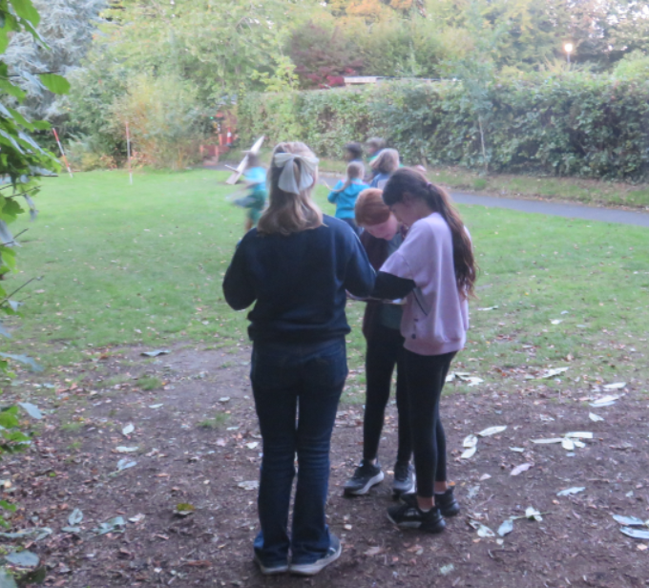
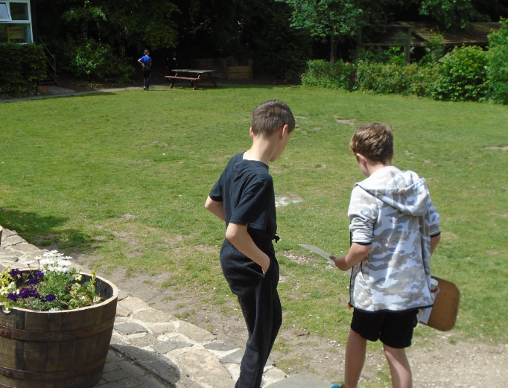
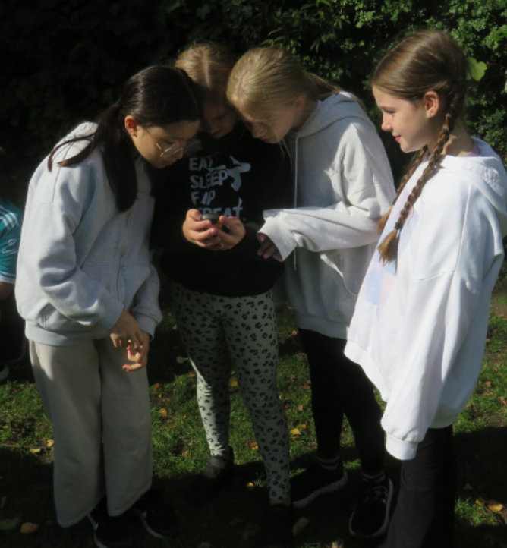
Orienteering
On-site
Two different types (maps and GPS)

Slide 15
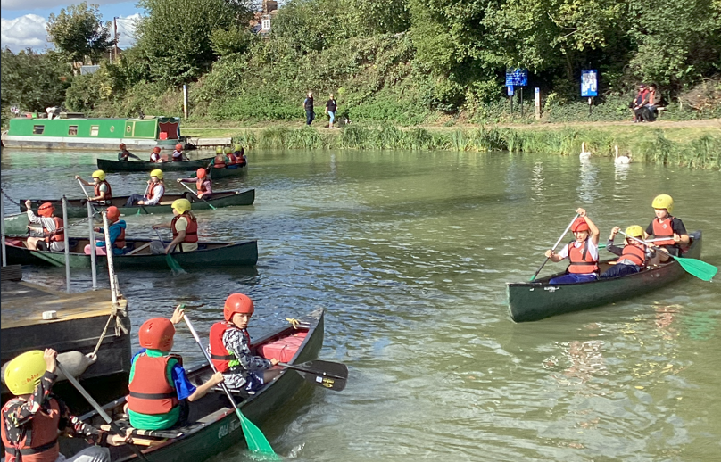
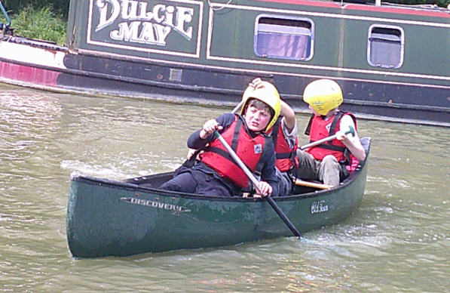
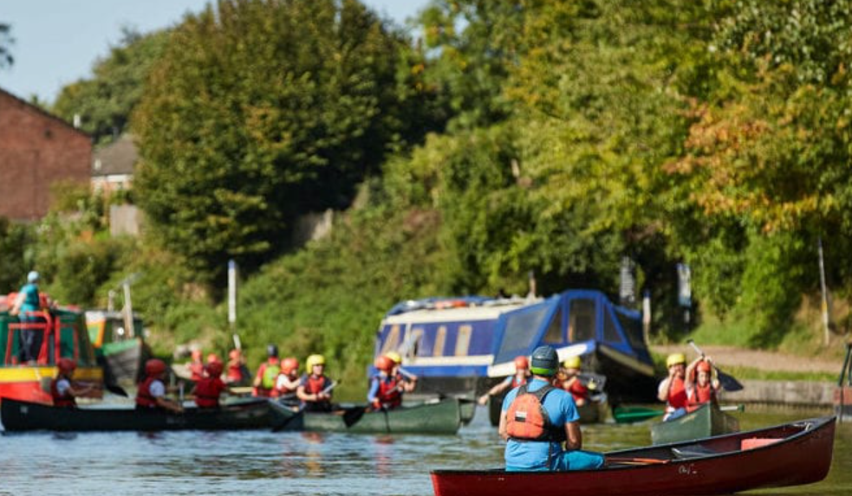
Canoeing
Walk to Devizes Wharf
Life jackets
Helmets
Adults more likely to fall in!

Slide 16
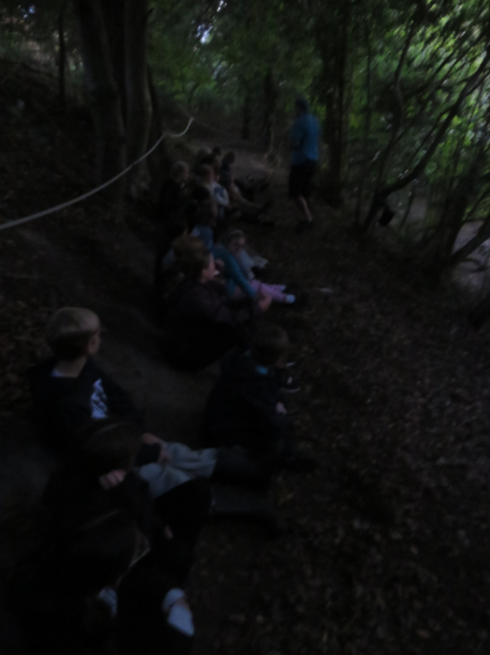
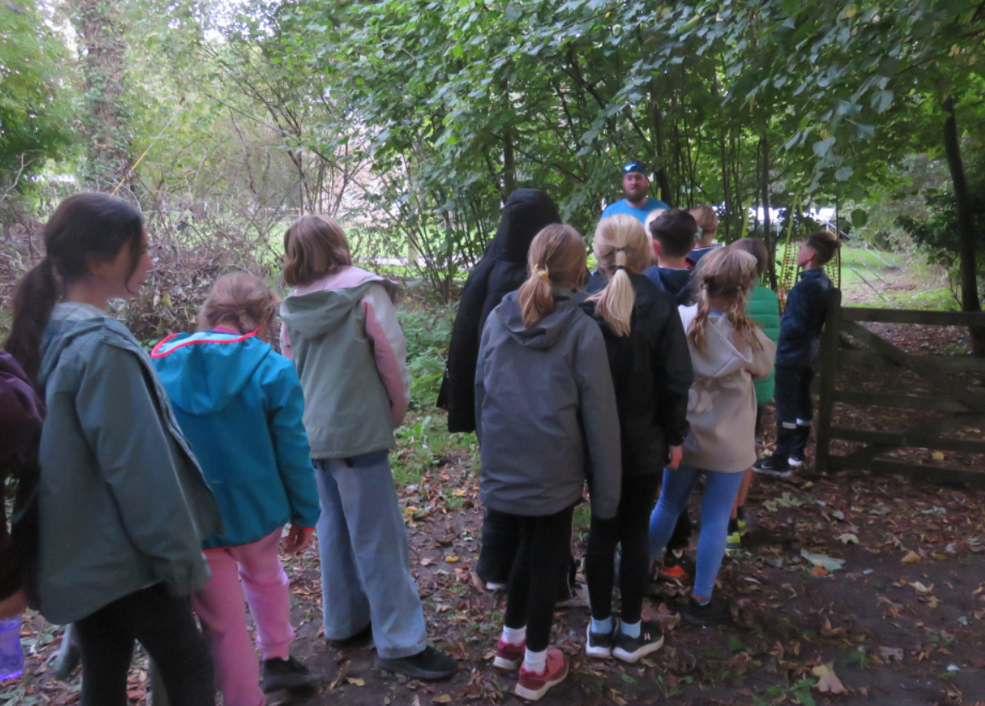
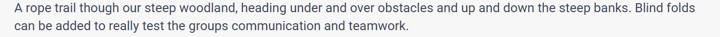
Nightline

Slide 17
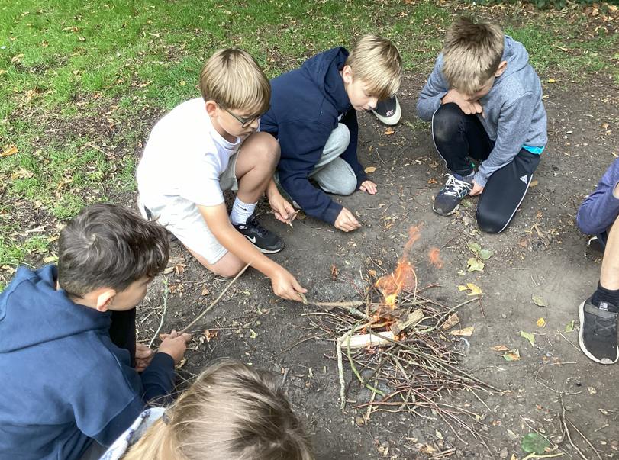
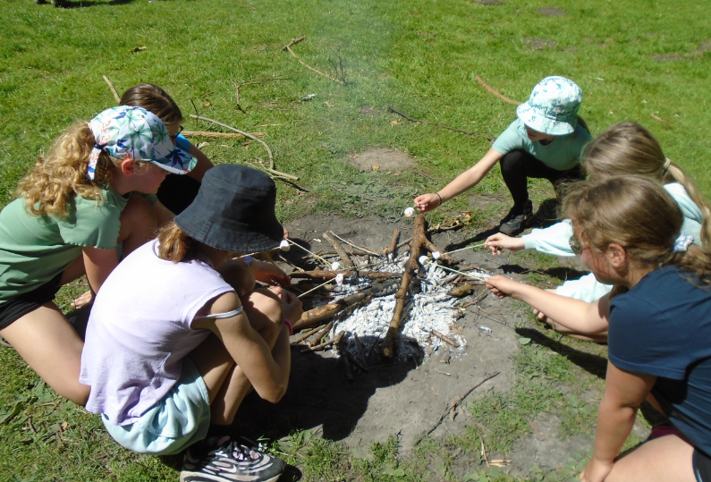
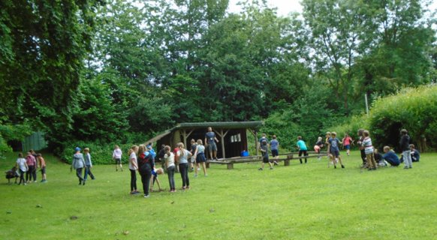
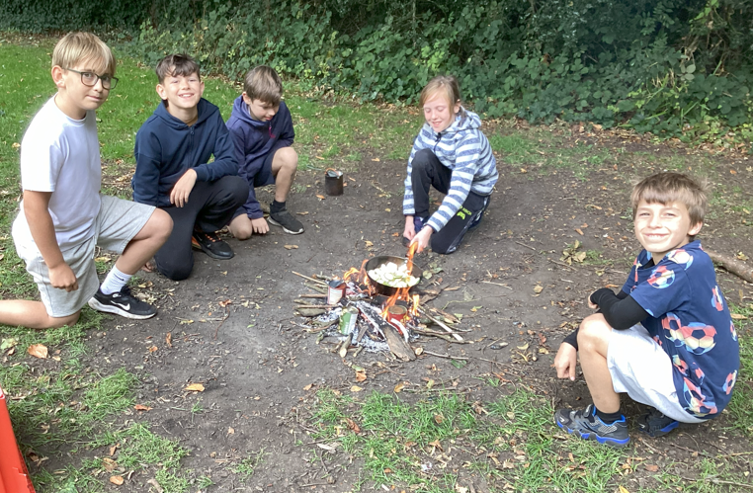
Survival Morning
On-site
Making our own campfire
Cooking lunch on fire

Slide 18
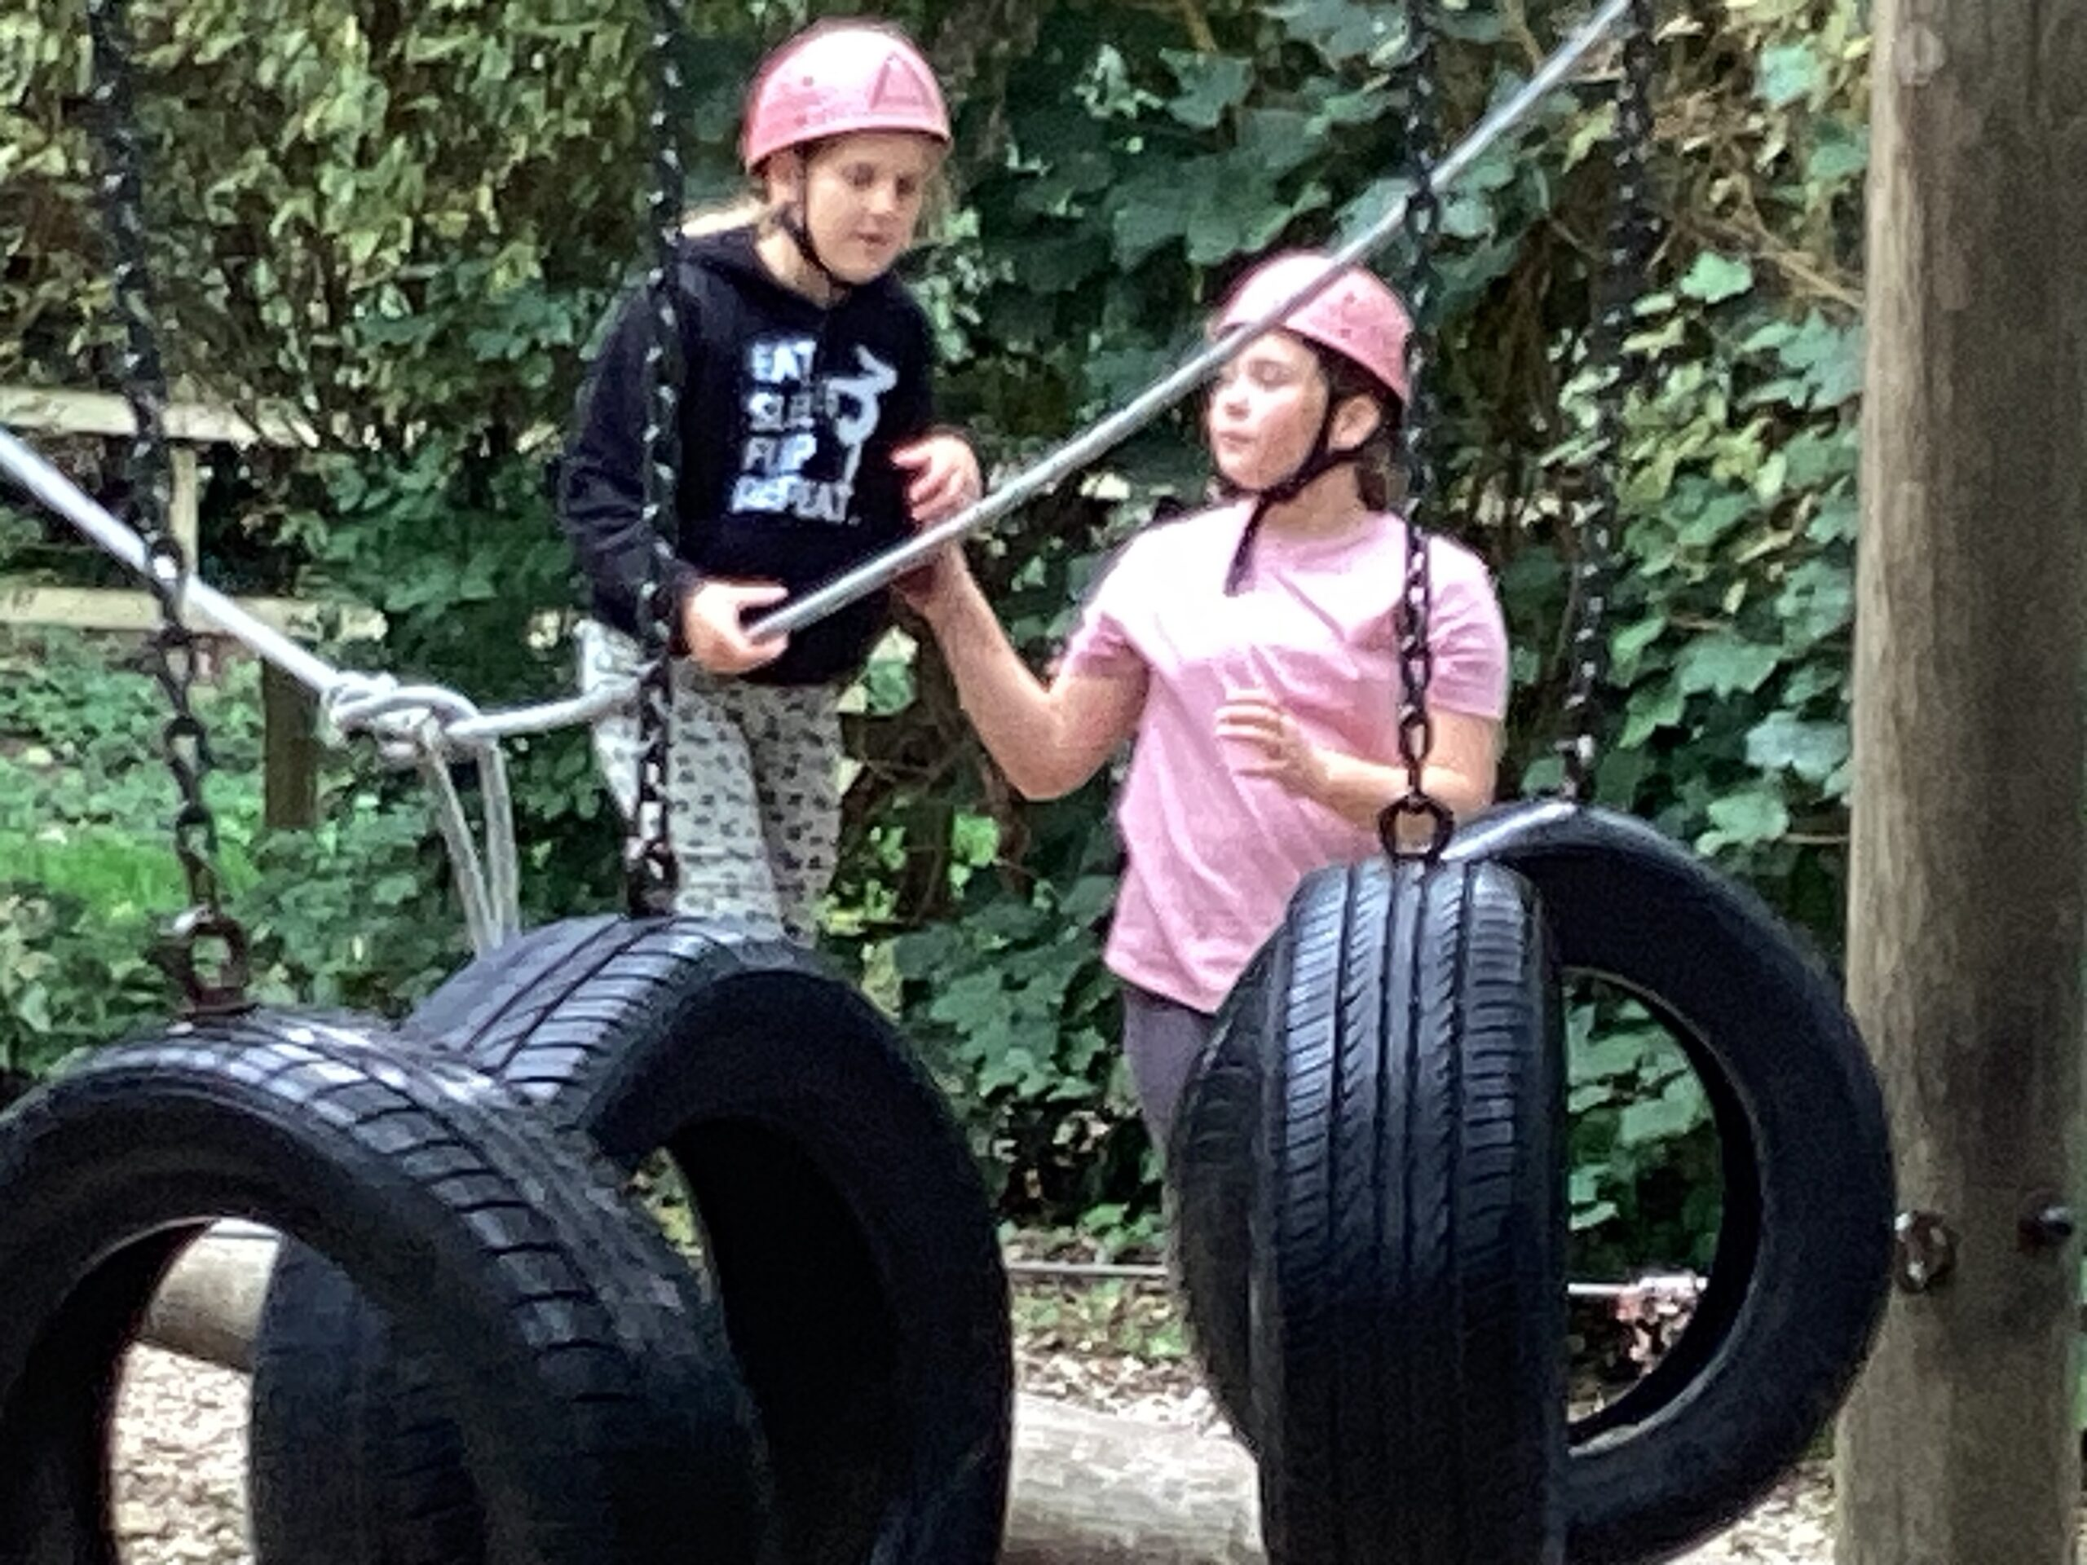
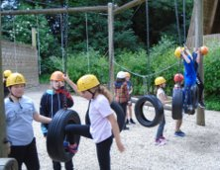
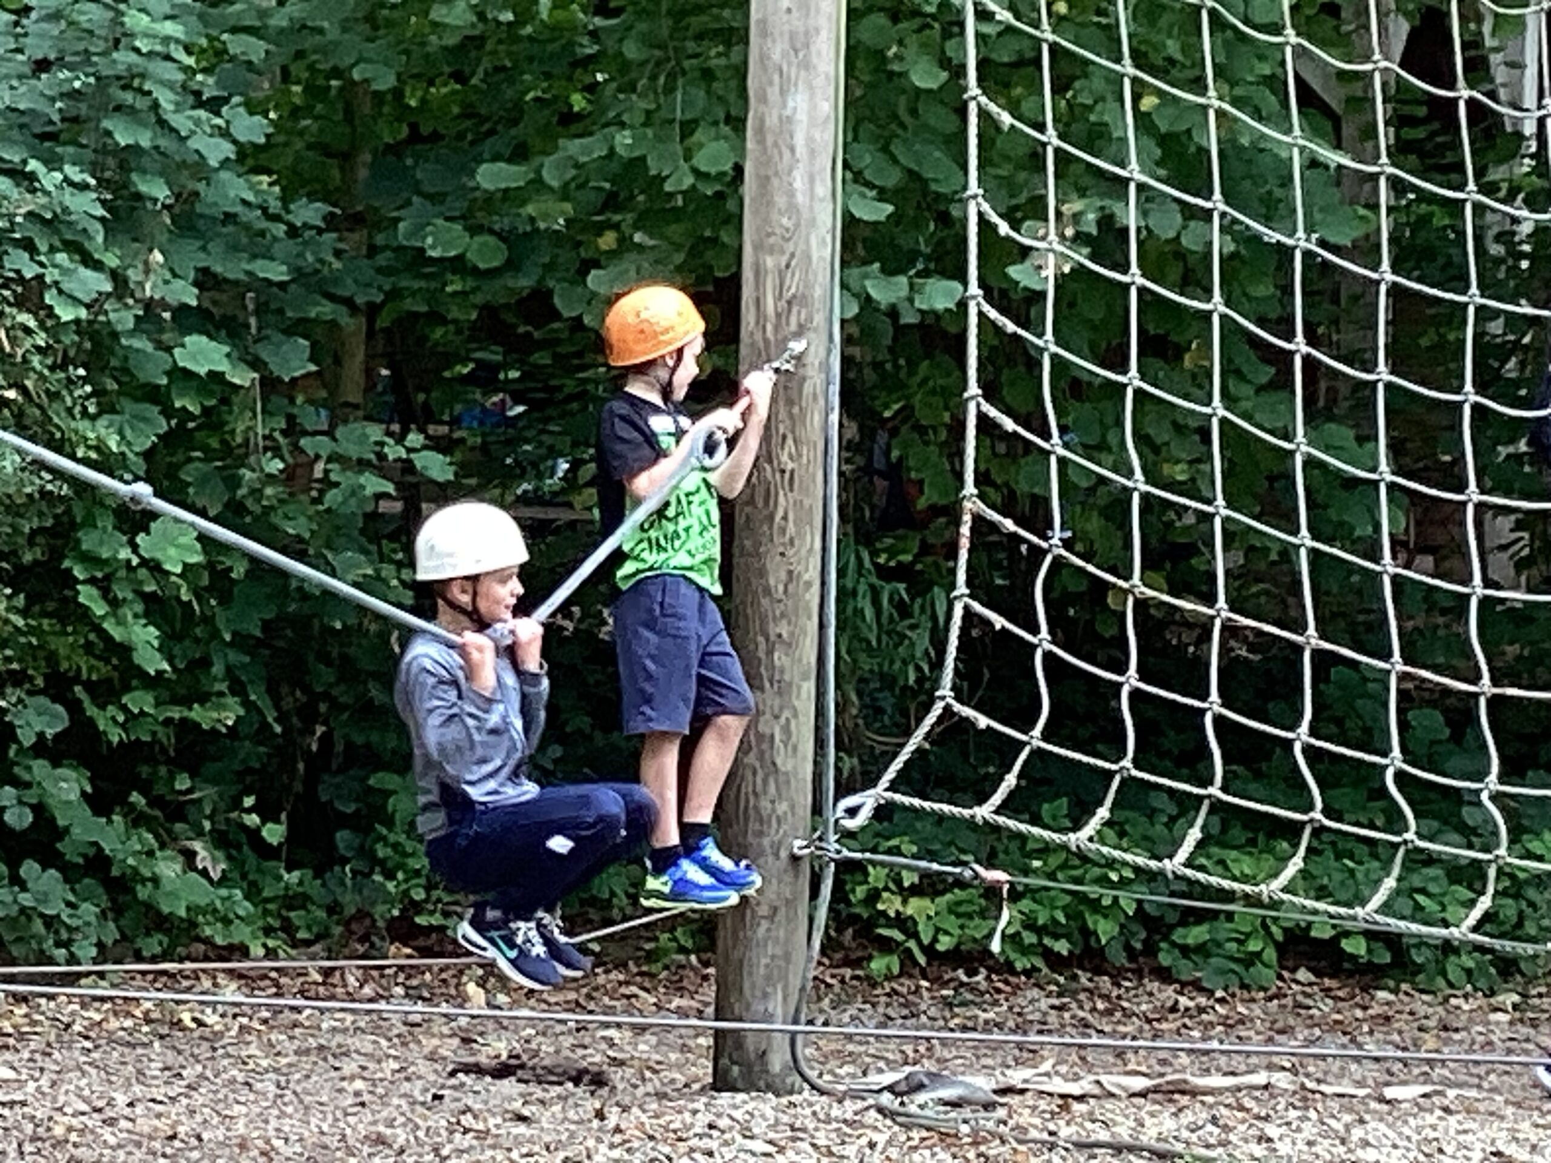
Low Ropes
On-site
Adventure course
Working collaboratively

Slide 19
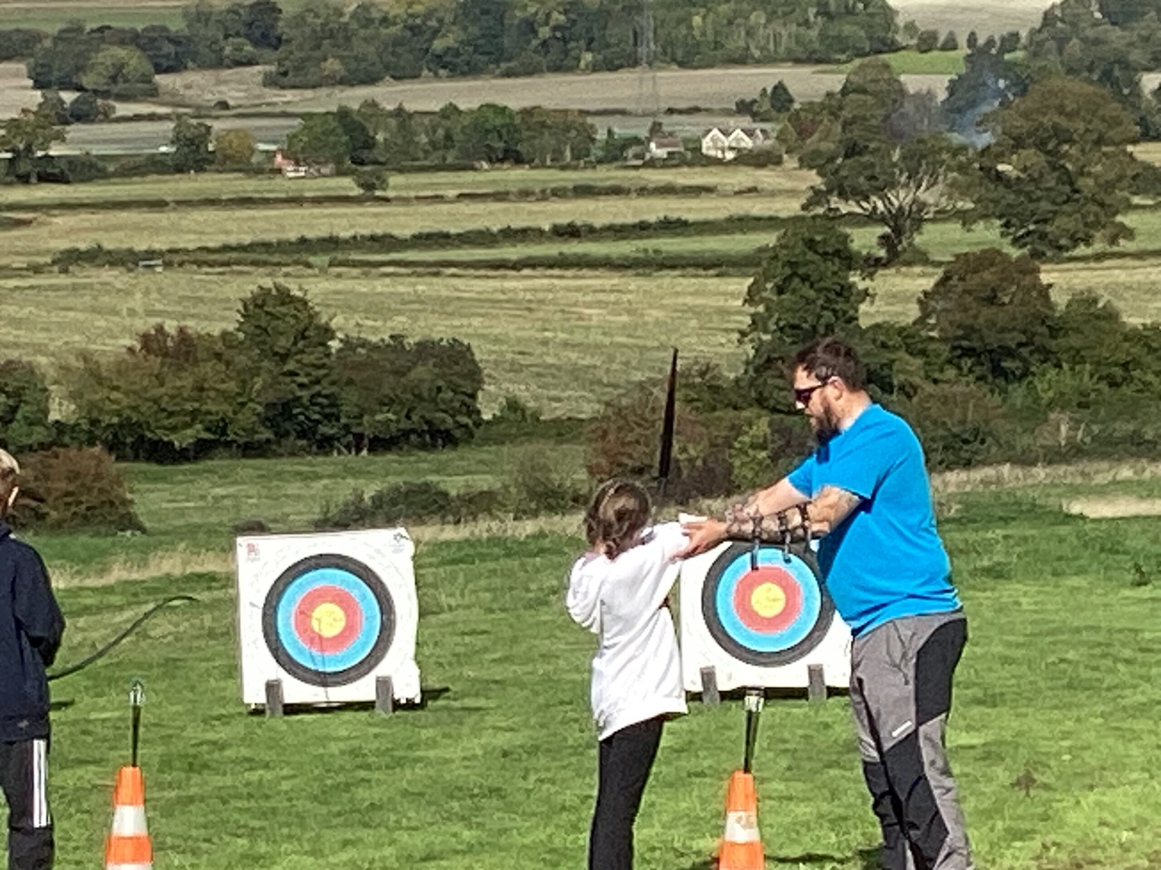
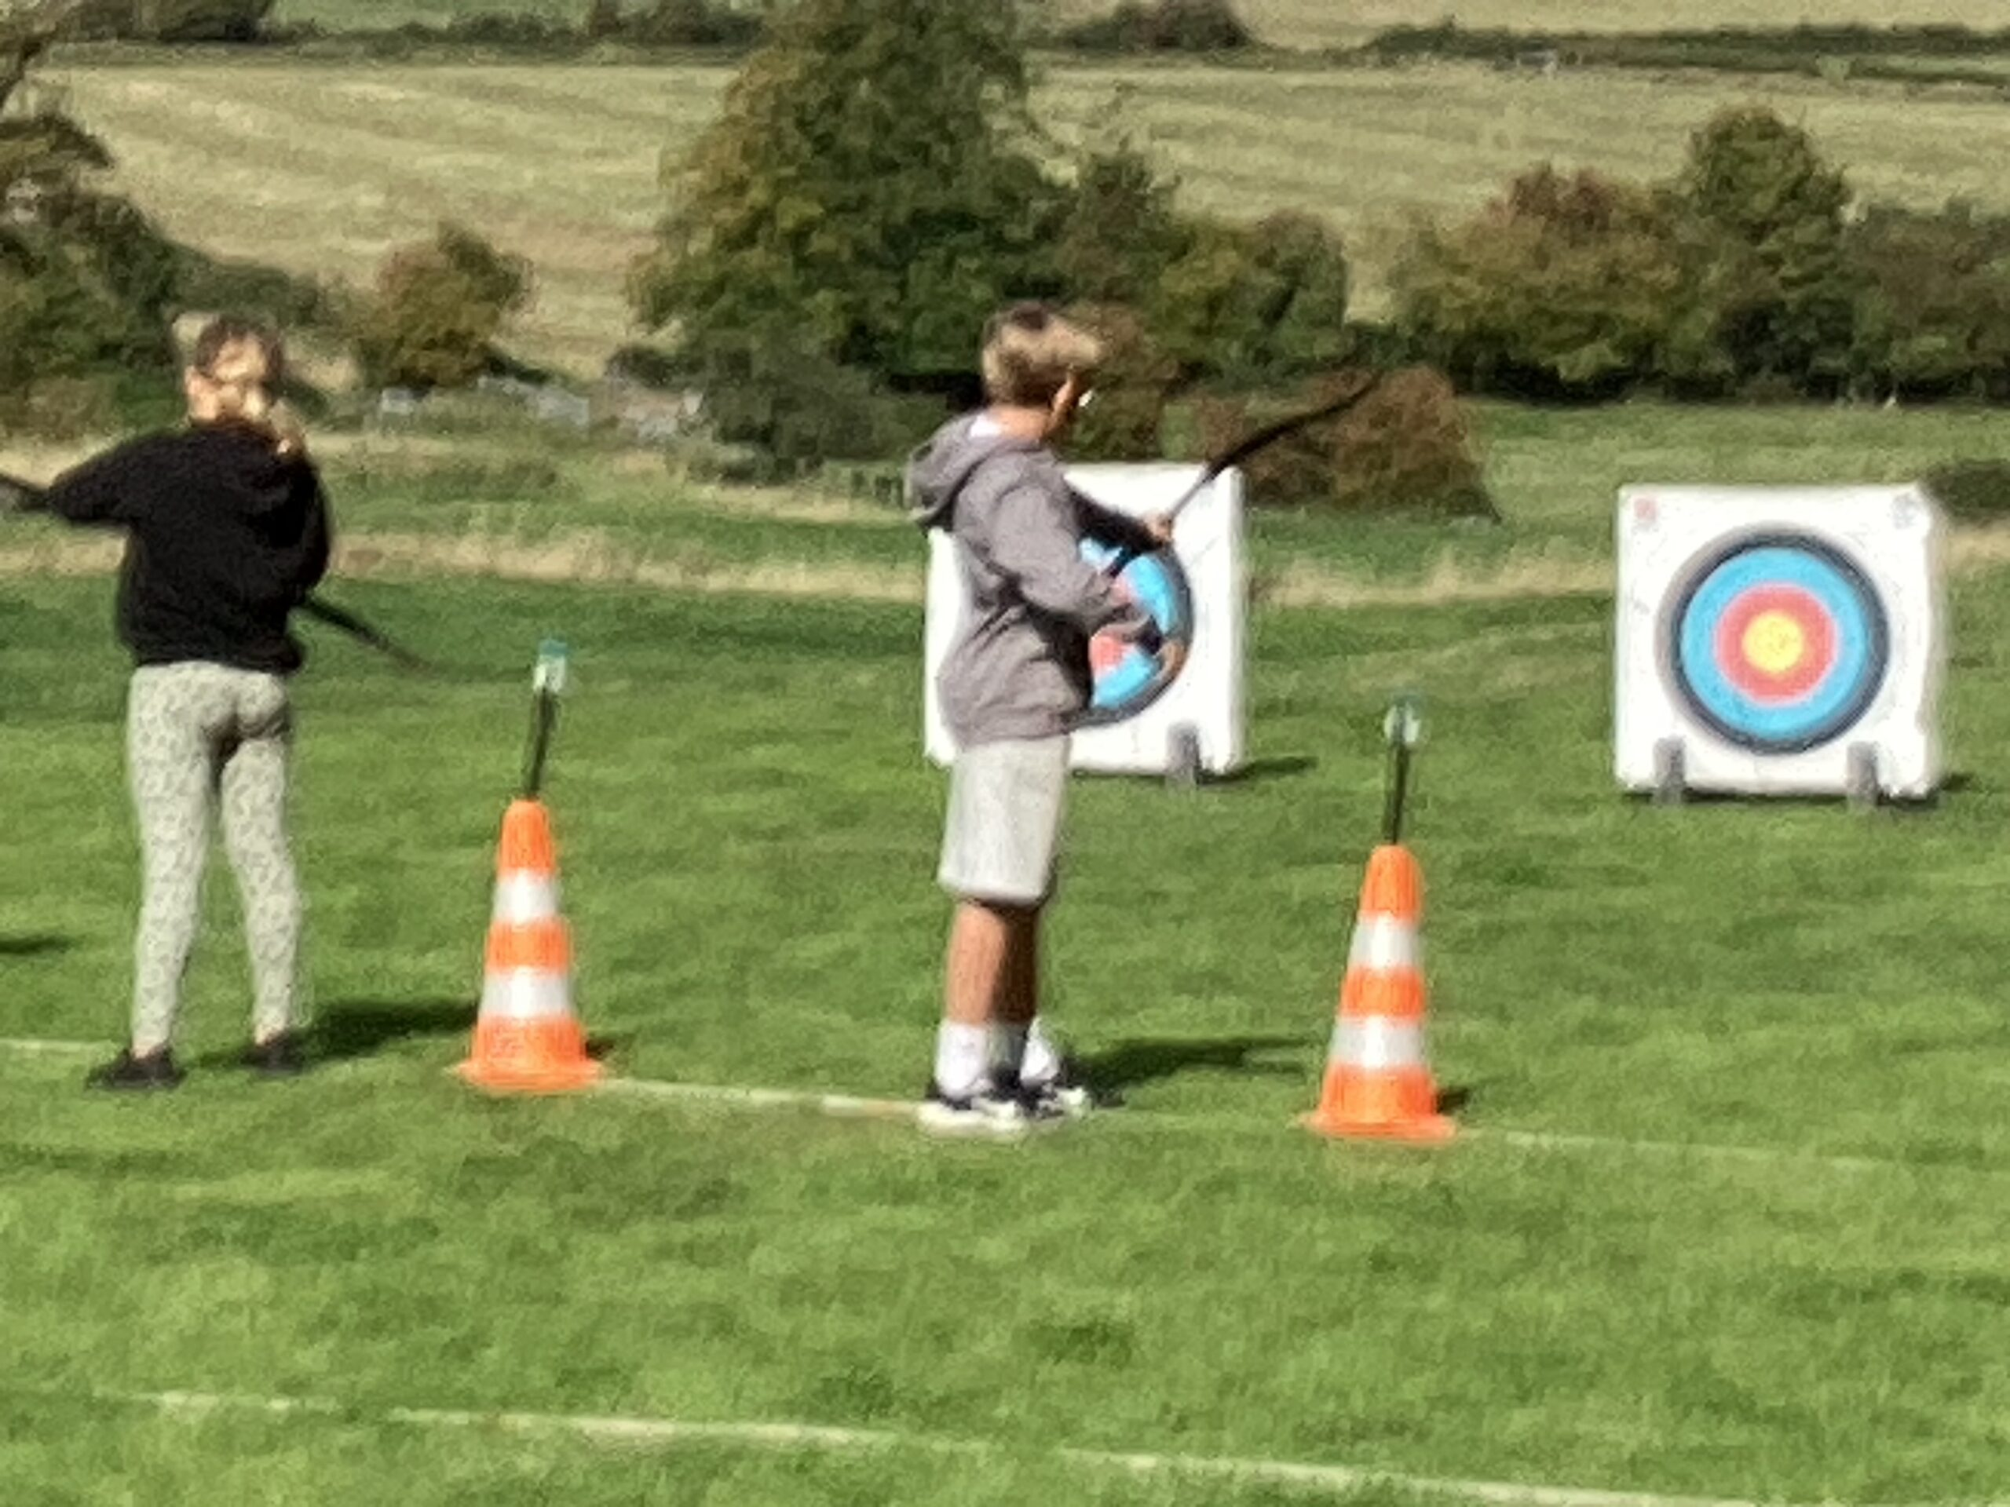
Target Archery
New to Braeside and our residential trips, learn a new skill and activity - target archery is the kind played at the Olympic and Paralympic Games!

Slide 20
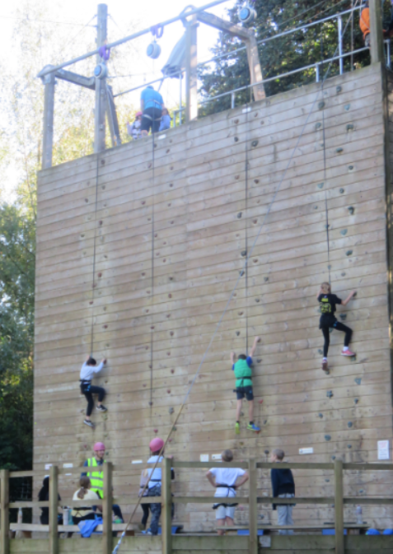
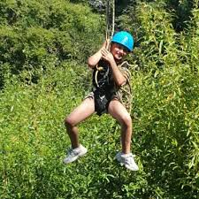
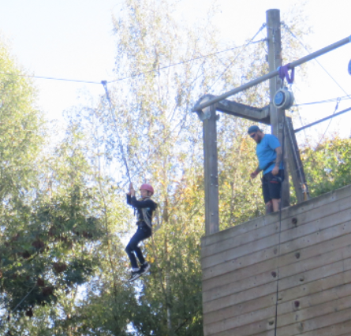
Climbing wall / Zip Wire
On-site
Various courses
A 115 metre zip wire running from the top of the climbing wall across the Braeside grounds and pond.

Slide 21
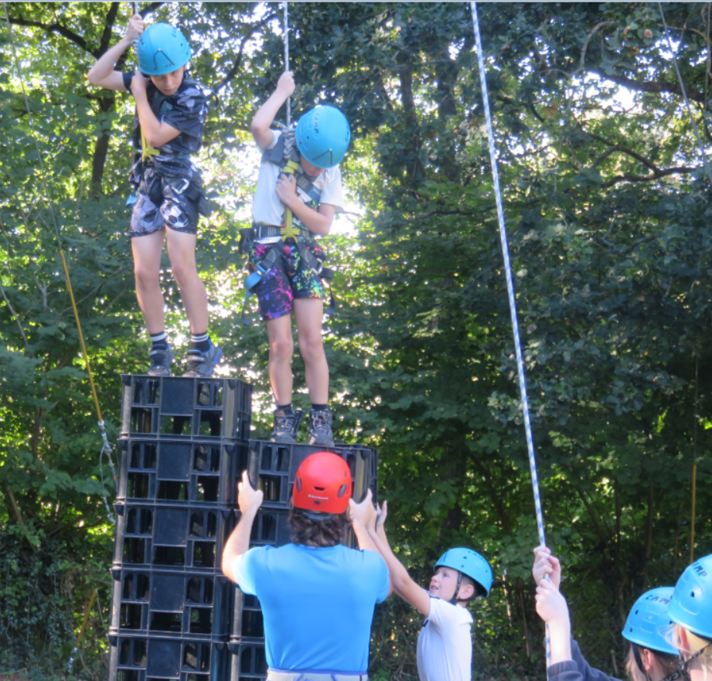
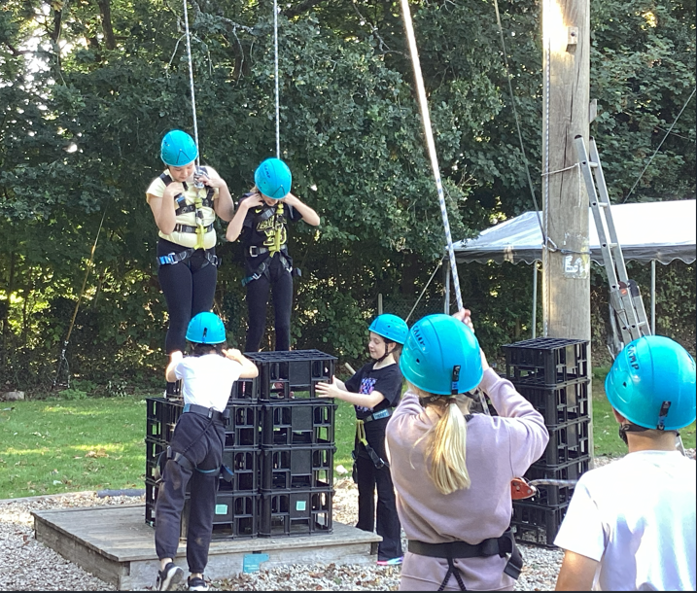
Crate Stacking
Different challenges
Team-work
Problem-Solving

Slide 22
Kit List
All bedding is provided at the centre.
Indoor shoes (slippers or clean trainers) | Outdoor shoes (something you don’t mind getting muddy and can walk in – walking shoes or wellies) | Wash bag – (e.g. toothbrush, toothpaste, hairbrush (NO SPRAYS – e.g. deodorant please) | Towel
Waterproof coat | Jumpers/fleeces | Small torch | Book for reading
Socks | T-shirts (many thin layers!) | Plastic lunch box (2 litres ice cream type is fine). Your child will need a packed lunch for Wednesday. | Small rucksack (just the normal type they bring to school)
Underwear | Trousers / shorts | Some plastic bags for dirty clothes and shoes | Water bottles (named)
Nightwear | Sun hat/sun cream (if hot) | Optional: Teddy bear/cuddly! £10 (maximum spending money) preferably in ‘small’ change.

Slide 23
NO CAMERAS, COMPUTER GAMES
MOBILE PHONES OR
NOISY THINGS
PLEASE!

Slide 24
Medicines
Complete the medication form – this was sent on the letter about tonight’s meeting(Microsoft Forms). Please complete before the summer holidays.
If any changes in September, in between please let me know.
Any medication hand over to Mrs Ray Wednesday morning. Mrs Ray will keep safe.
All medication will be administered by Mrs Ray and another adult.
No other medication (e.g. paracetamol) to be carried by the children.

Slide 25
If you need to contact us:
Contact school
In an emergency contact Braeside 01308 862260
We will give updates to school throughout our time away!

Slide 26
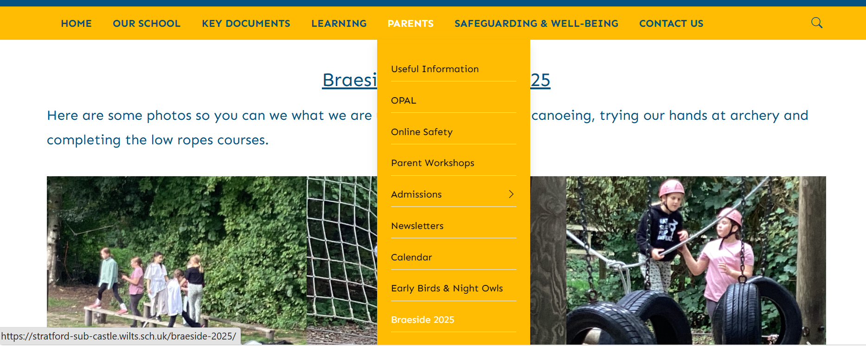
Our website – all letters etc

Slide 27
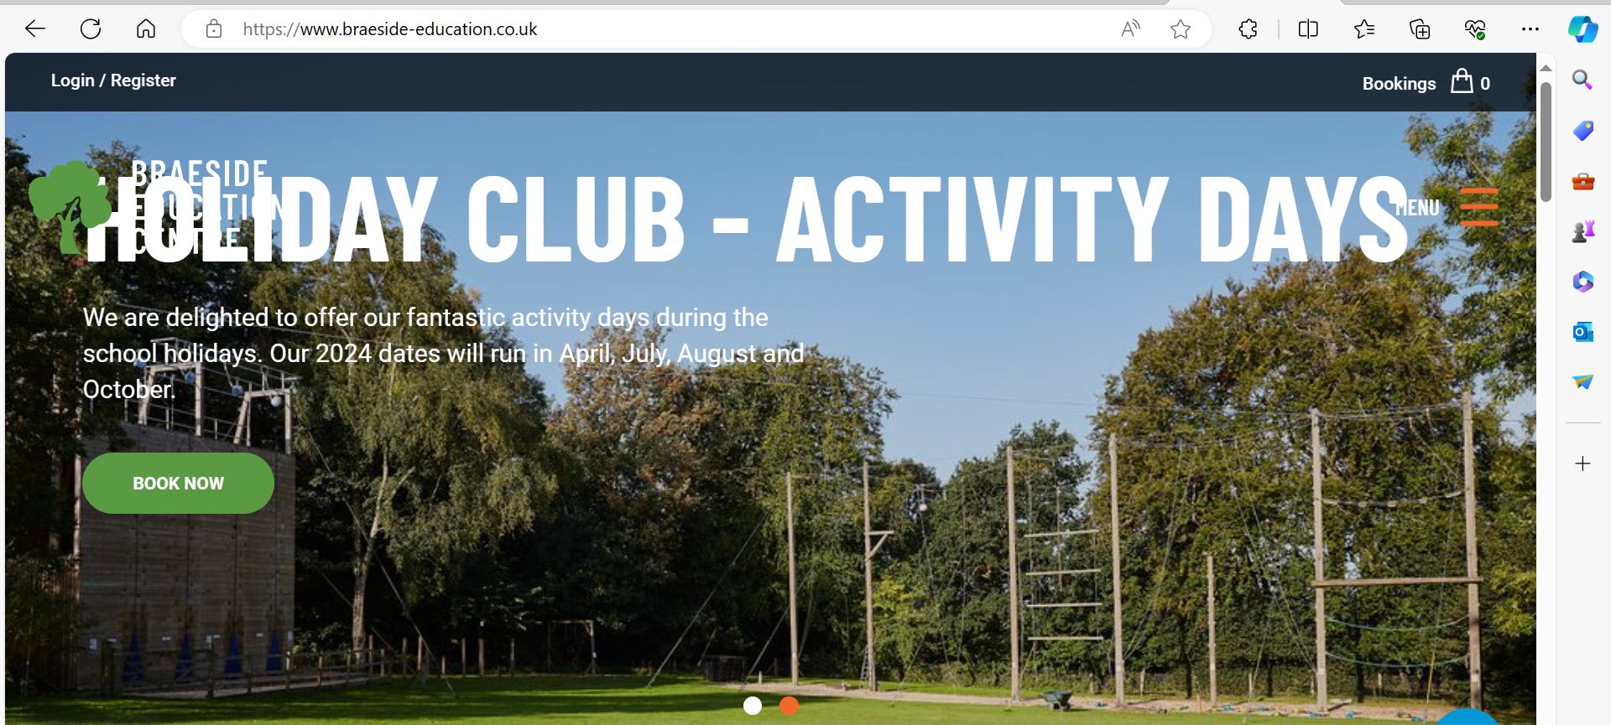
Look on their website

Slide 28
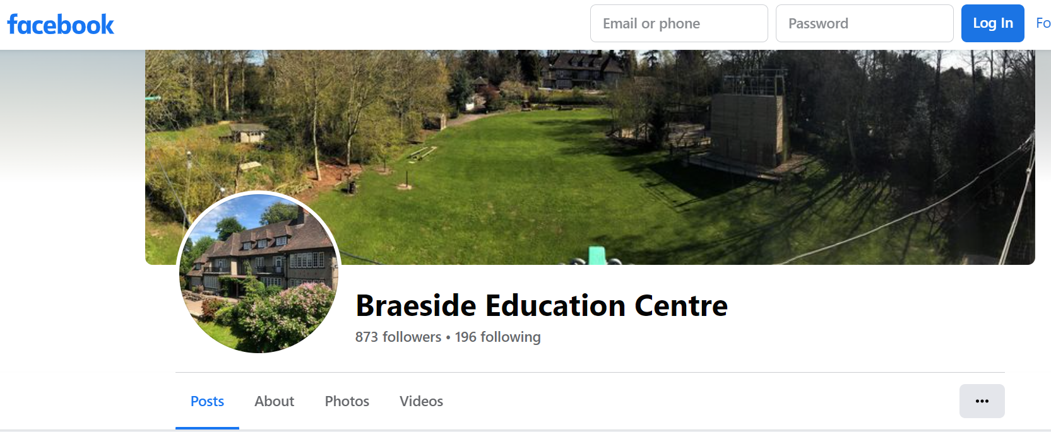
Facebook

Slide 29
Any questions?
Feel free to leave the meeting if you do not have any questions.

